Slide 1
IBM Digital Business Automation Applying ODM rules to PDF forms

Slide 2
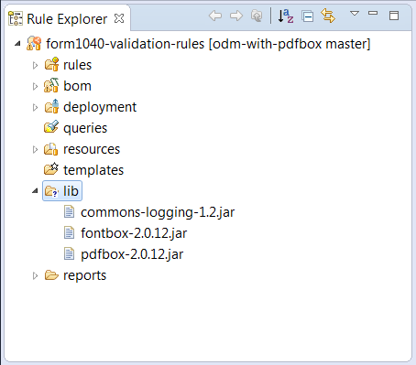
Step 1: XOM set-up
Create a lib folder under the form1040-validation-rules project.
Copy commons-logging-1.2.jar from Apache Commons under lib.
Copy pdfbox-2.0.12.jar and fontbox-2.0.12.jar from Apache PDFBox under lib.

Slide 3
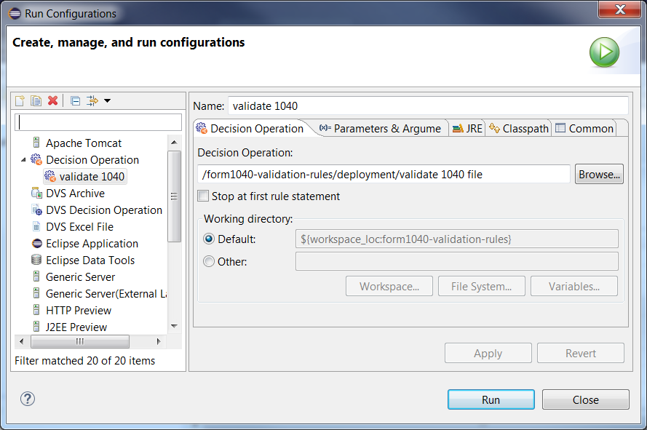
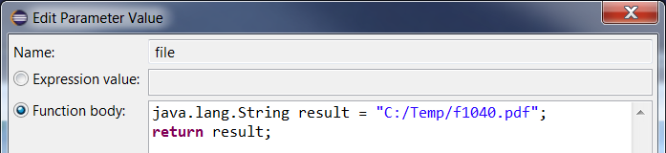
Step 2: Sample execution in ODM Rule Designer
Create a run configuration for decision operation and select the validate 1040 file operation.
Provide the path to the form document for the file parameter value.
Run the configuration.

Slide 4
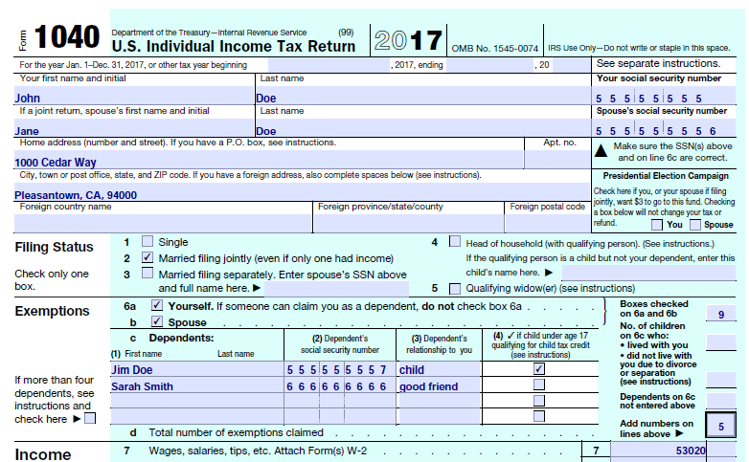
Sample output
Using the sample form 1040 provides in the doc folder, the output of the rule execution is the following:
Starting form validation.
Warning: AGI is low compared to total income
Warning: IRA deduction is over the limit
Warning: Confirm dependents can actually be claimed by payer
Warning: Verify claim for educator expenses
Form validation completed.

Slide 5
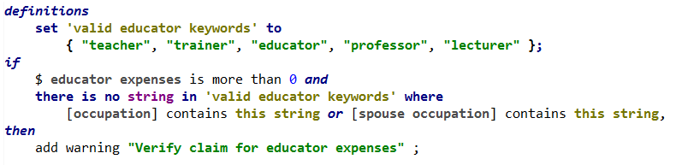

Sample rule 1
The following rule checks whether educator expenses are claimed when the person who files the return or the spouse do not appear to have an occupation related to education.

Slide 6
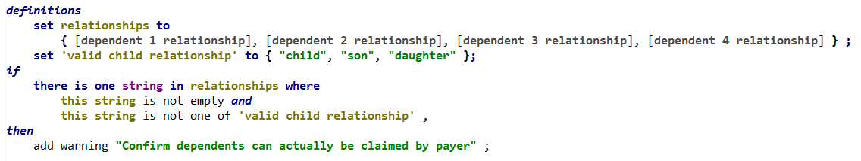

Sample rule 2
The following rule checks whether the dependents listed are children of the person who files the return. If they are not, add a warning to confirm they can actually be claimed as dependents.

